Slide 1



UNIT 5; It takes drive
They’ve succeeded

Slide 2
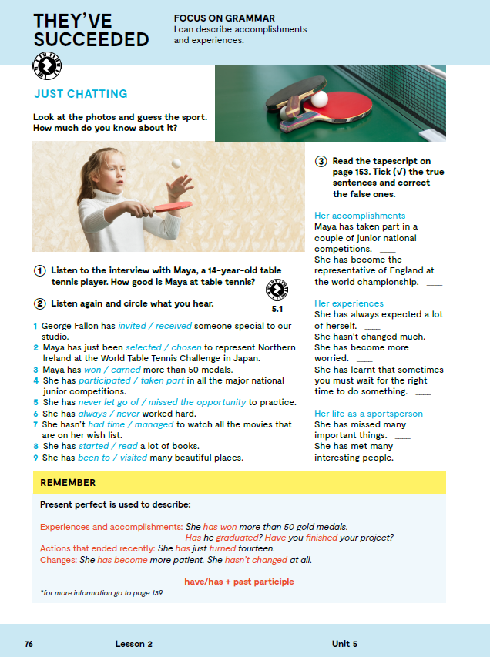
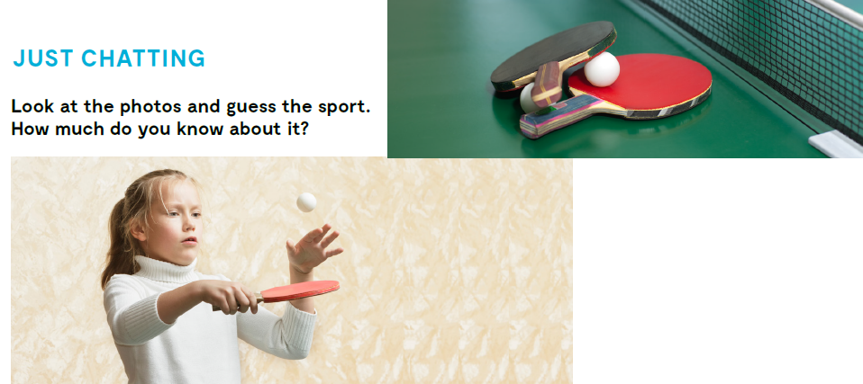

Slide 3



Slide 4
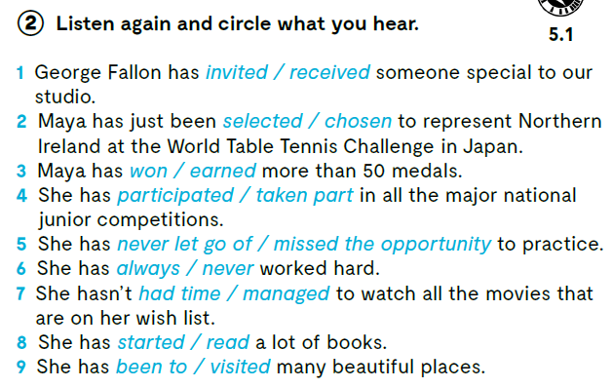


Slide 5
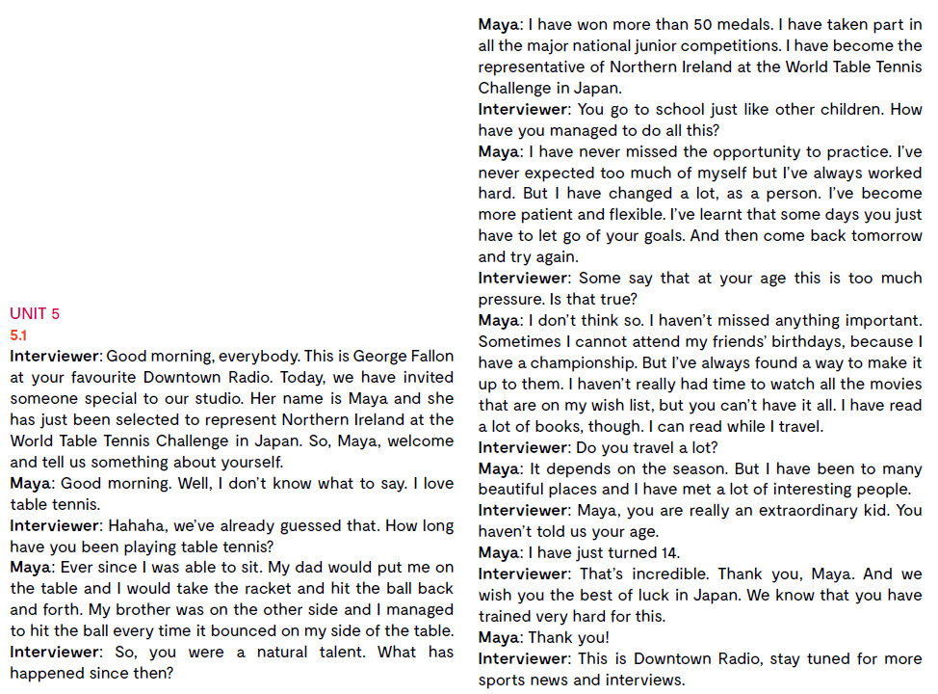
Read the tapescript on page 153. Tick (√) the true sentences and correct the false ones.

Slide 6
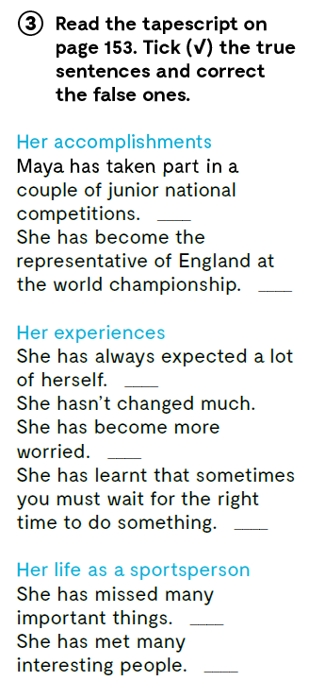

Tick (√) the true sentences and correct the false ones.
Maya has taken part in all the major national junior competitions.
She has become the representative of Northern Ireland at the world championship.
She has never expected too much of herself.
She has changed a lot.
She has become more patient and flexible.
She hasn't missed anything important.

Slide 7
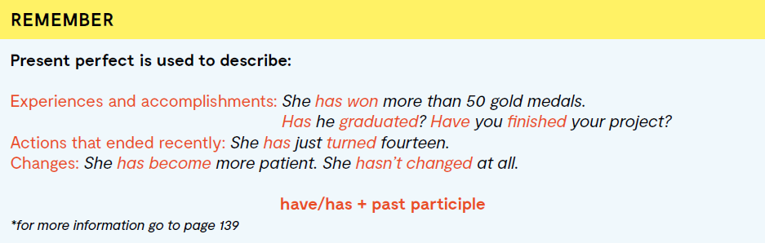
Present perfect koristimo za opisivanje iskustava i postignuća, radnji koje su nedavno završile, promjena.
Tvorba:
HAVE/HAS + glagol u PAST PARTICIPLE obliku
*pravilnim glagolima dodamo nastavak –d ili –ed, dok nepravilne glagole potražimo u 3. stupcu popisa nepravilnih glagola

Slide 8
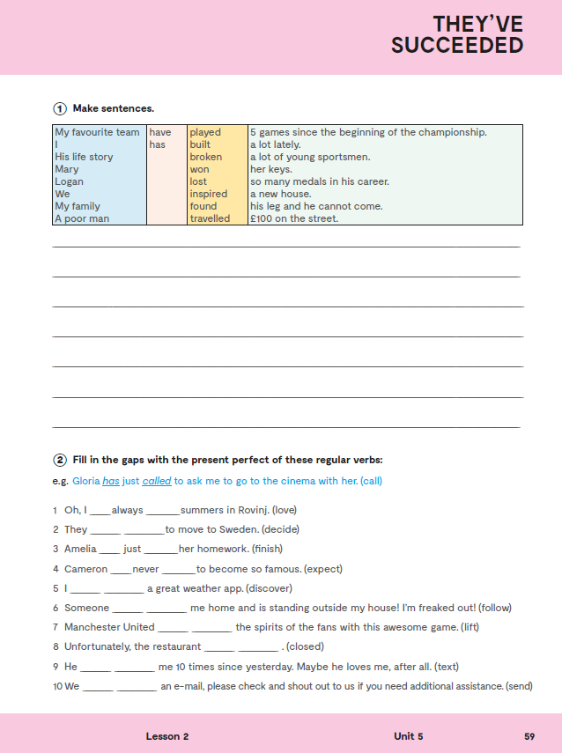
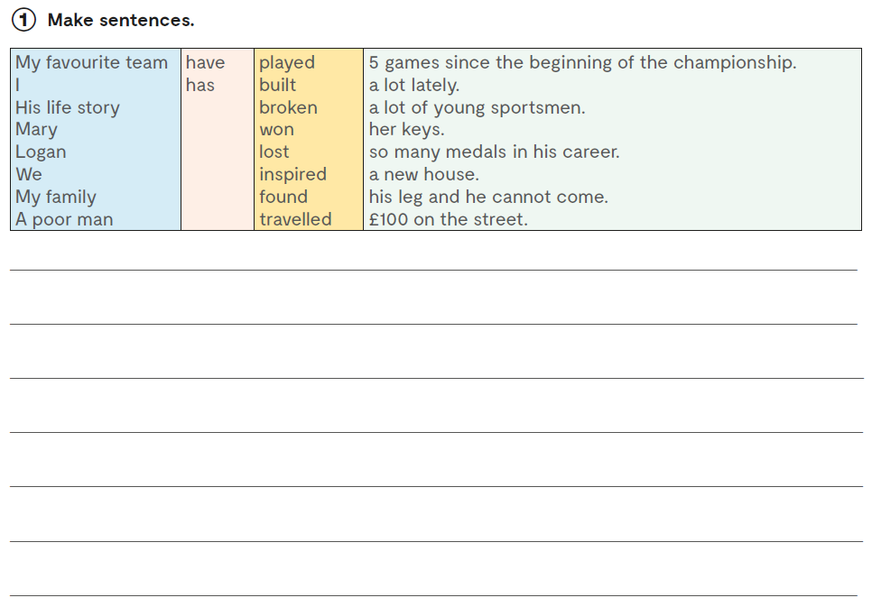
Workbook, p. 59
My favourite team has played 5 games since the beginning of the championship.
I have …

Slide 9
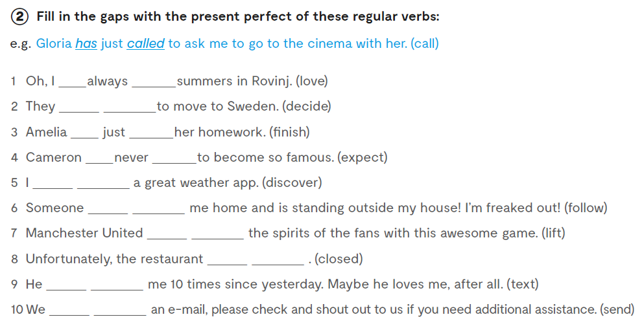
have loved
have decided
has finished
has expected
have discovered
has followed
have lifted
has closed
has texted
have sent

Slide 10
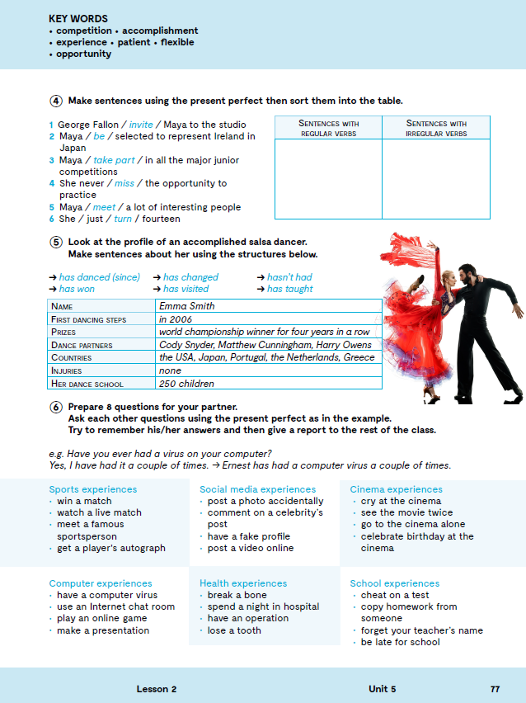
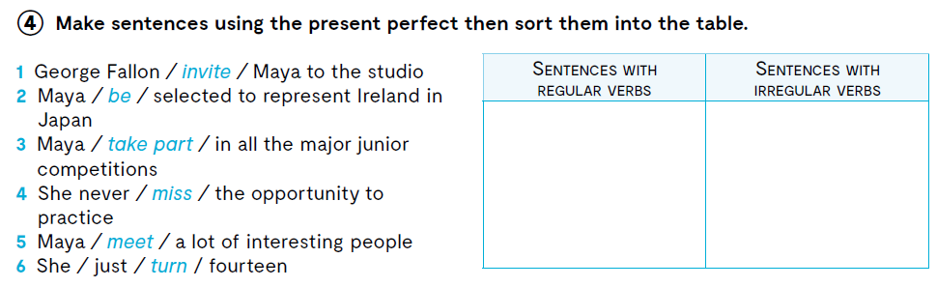
George Fallon has invited Maya to the studio.
She has never missed the opportunity to practice.
She has just turned fourteen.
Maya has been selected to represent Ireland in Japan.
Maya has taken part in all the major junior competitions.
Maya has met a lot of interesting people.

Slide 11
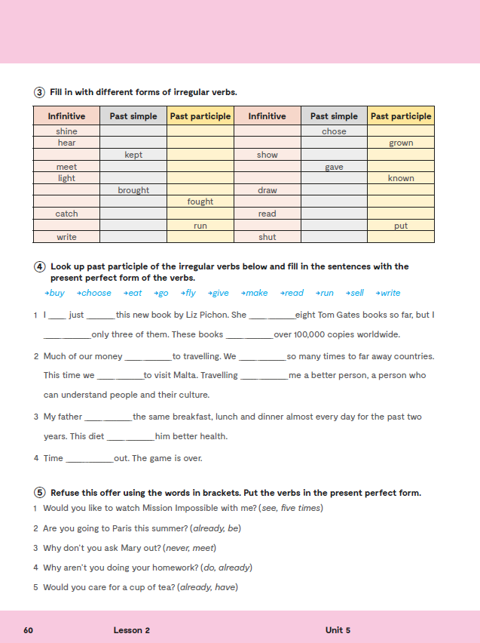
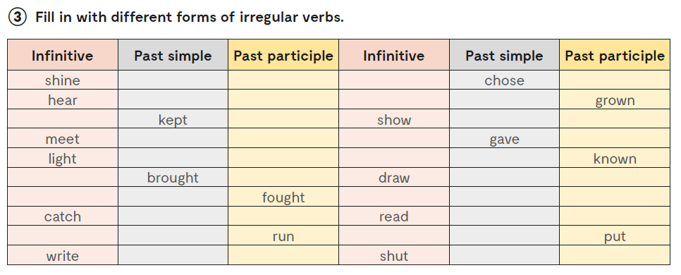
Workbook, p. 60
shone
shone
heard
heard

Slide 12
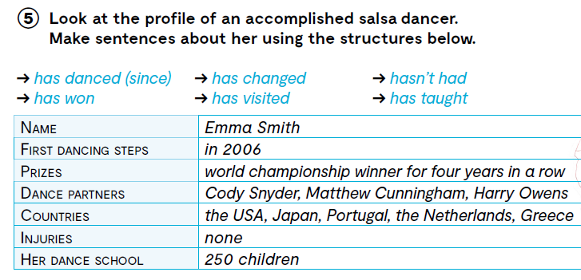

Slide 13

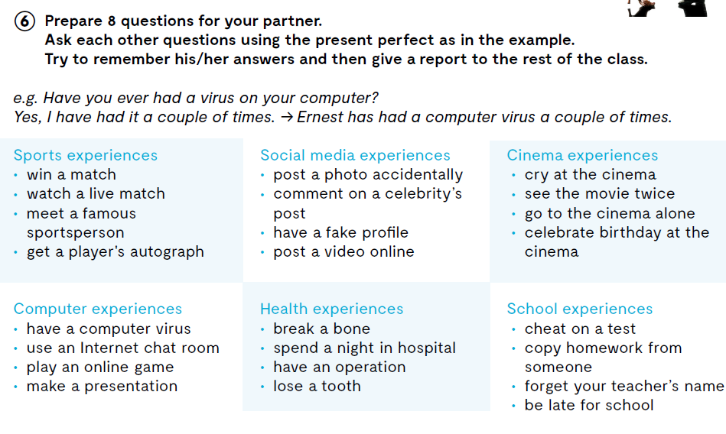
Let’s practise: https://wordwall.net/play/846/382/949

Slide 14
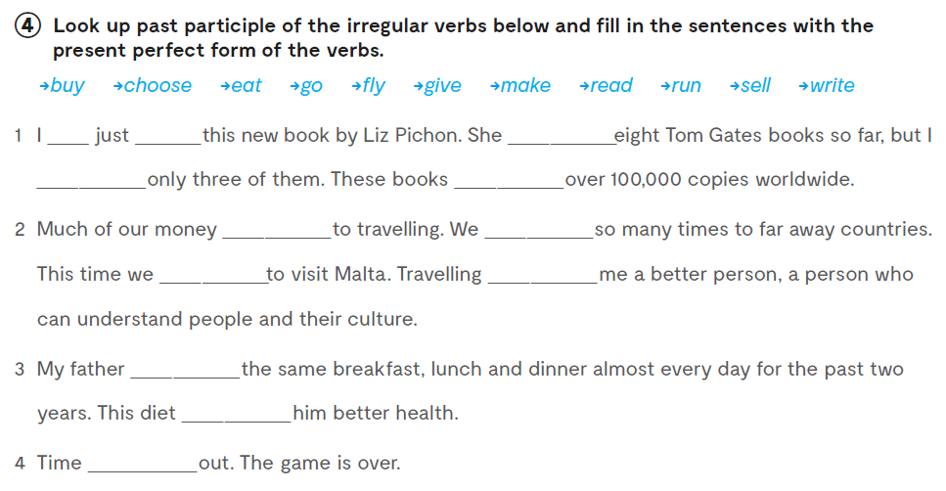
Workbook, p 60
have bought
has written
have read
have sold
has gone
have flown
have chosen
has made
has eaten
has given
has run

Slide 15
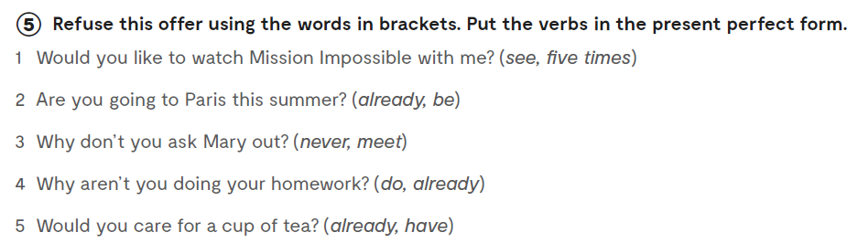
1 No, thank you! I have seen it five times.
2 No, I have already been there.
3 How could I? I have never met her.
4 I have already done it.
5 No, thanks. I have already had some.

Slide 16

LEARN MORE
https://www.e-sfera.hr/dodatni-digitalni-sadrzaji/c02e750f-ba41-42f9-b0c5-c784f53d6e79/
New sports

